Slide 1
Final Engagement
Attack, Defense & Analysis of a Vulnerable Network
Team Members: Angus Young, Andrew Pegg, Norman Lam-Saw

Slide 2
Table of Contents
This document contains the following resources:
Network Topology & Critical Vulnerabilities
Alerts Implemented
Hardening
Implementing Patches

Slide 3

Network Topology
& Critical Vulnerabilities
‹#›

Slide 4
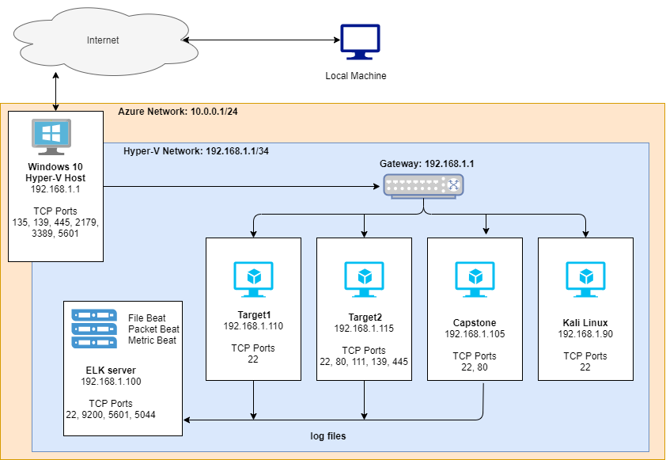
Network Topology
Network Address Range: 192.168.1.0/24
Netmask: 255.255.255.0
Gateway: 192.168.1.1
Machines
IPv4: 192.168.1.105
OS: Ubuntu 18.04.1 LTS
Hostname: CAPSTONE
IPv4: 192.168.1.100
OS: Ubuntu 18.04.4 LTS
Hostname: ELK
IPv4: 192.168.1.110
OS: Linux 3.2-4.9
Hostname: TARGET 1
IPv4: 192.168.1.115
OS: Linux 3.2-4.9
Hostname: TARGET 2

Slide 5
Critical Vulnerabilities: Target 1
Our assessment uncovered the following critical vulnerabilities in Target 1.
Vulnerability | Description | Impact
Open access to SSH | An attacker can try SSH logins if the port is left open. | Open access is vulnerable to brute force attacks that need to be addressed.
Brute Force vulnerability | Attackers can perform rapid attempts to guess user names and passwords. | Brute force will eventually, with enough time, gain access to the system.
Enumerate WordPress | Gather information and detect vulnerabilities on the system. | Revealing login name to SSH greatly reducing the time required to brute force.

Slide 6
Alerts Implemented
‹#›

Slide 7
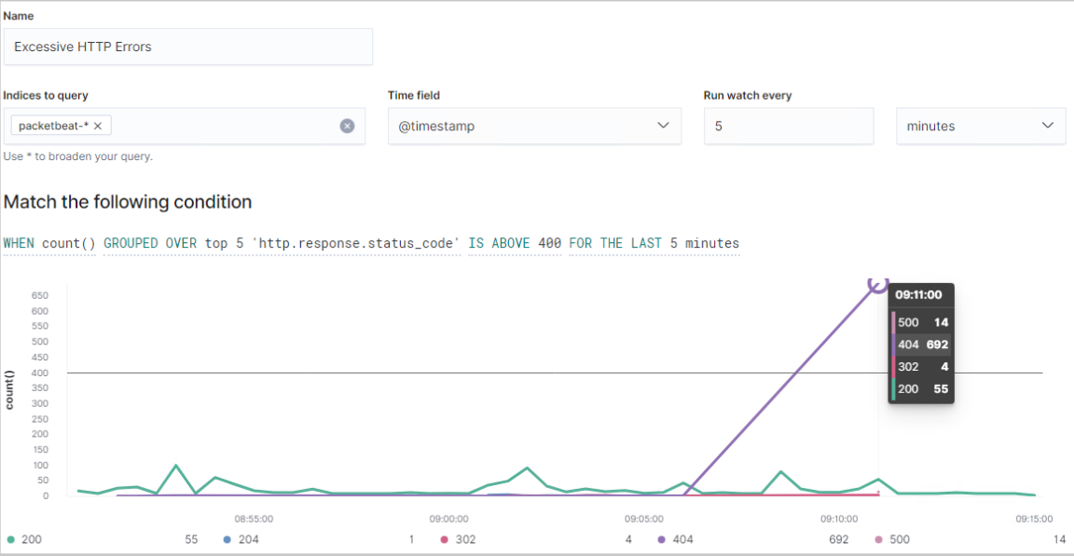
Excessive HTTP Errors
Which metric does this alert monitor? Packetbeat
What is the threshold it fires at? When count() GROUPED OVER top5 ‘http.response.status_code’ is above 400 for the last 5 minutes
Provide a screenshot of the alert in action.

Slide 8
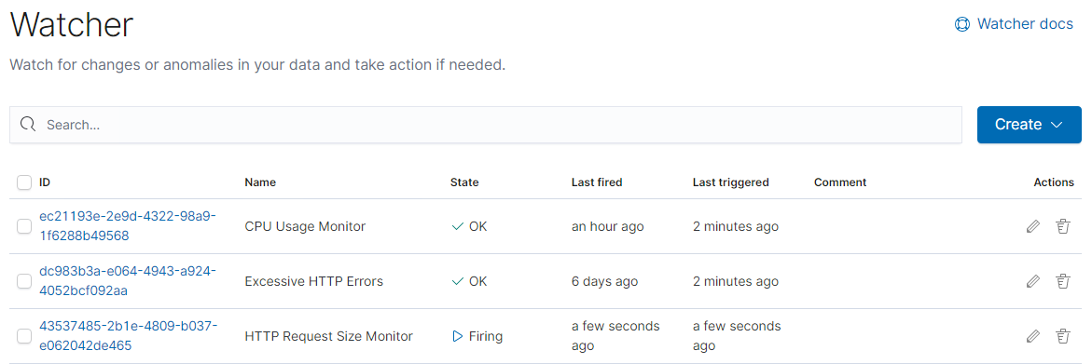
HTTP Request Size Monitor
Summarize the following:
Which metric does this alert monitor? Packetbeat
What is the threshold it fires at? When sum() of http.request.bytes OVER all documents is ABOVE 3500 for the LAST 1 minute
Provide a screenshot of the alert in action.

Slide 9
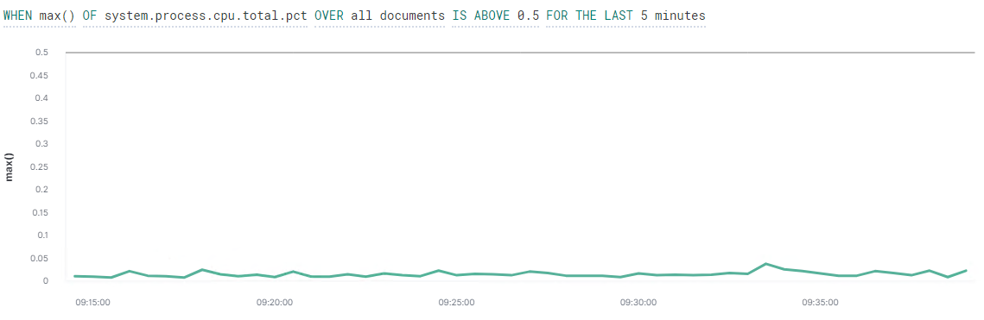
CPU Usage Monitor
Summarize the following:
Which metric does this alert monitor? Metricbeat
What is the threshold it fires at? WHEN max() OF system.process.cpu.total.pct OVER all documents IS ABOVE 0.5 FOR THE LAST 5 minutes
Provide a screenshot of the alert in action.

Slide 10
Hardening
‹#›

Slide 11
Hardening Against: open access to SSH 22 on Target 1
Explain how to patch Target 1 against Vulnerability 1. Include:
Firewall: A firewall can detect port scans and be configured to act on them such as closing port 22 or blocking 22 from the IP which conducted the scan.
Whitelist IP Addresses and Domain Names: Access to the system via SSH can be configured to only accept connections from specific IP addresses or domain names.
Schedule SSH: You can schedule SSH port opening for specific times where the known administrators are known to work. This prevents unknown actors from scanning or attacking during these times.

Slide 12
Hardening Against: Brute Force Vulnerability on Target 1
Explain how to patch Target 1 against Vulnerability 2. Include:
Account lockout: Implement and account lockout policy, for example five failed logins per 10 minutes).
Strong Password Policy: Using a strong password that is long and not easy to guess can make brute forcing take enough time that the attack can be unfeasible. This includes password length, including symbols, numbers and upper/lower case alphabet characters. Password change schedules can be added to this.
MFA: Enable 2/Multi-Factor Authentication all logins.
Captcha: Used to detect and deny automated bots from login attempts. Generally only causes minor inconvenience to users.

Slide 13
Hardening Against: enumeration on Wordpress on Target 1
Explain how to patch Target 1 against Vulnerability 3. Include:
Update Wordpress: Stay updated with the latest version, including plugins. Updates will patch vulnerabilities and help harden your system.
Web application firewalls: Help monitor, restrict and alert against attacks against the applications.
Rule of Least Privilege: User and application accounts should only have the minimum privilege to perform their tasks. This helps harden against a compromised account moving laterally and accessing things they should not be able to.
REST API & XML-RPC: Uninstall or disable these if not in use.
Configure Wordpress: Remove author (user) names which is exposing system account users. Authors can use an alias.

Slide 14
Implementing Patches
‹#›

Slide 15
Implementing Patches with Ansible
Playbook Overview
Ansible will be used to automatic the update process on each machine. This process can be scheduled to run on a regular basis through cron job.
name: System Update
hosts: webservers
apt: update_cache=yes force_apt_get=yes cache_valid_time=3600
- name: reboot
- register: reboot_required_file
- stat: path=/var/run/reboot-required get_md5=no

